Slide 1


FSD-1 INDIVIDUAL PROJECT
PREPARED BY:-
NAME:- HARDIK .A. GOHEL
ROLL NO: 191
ENROLLMENT NO:22002170110036
BATCH: A6
BRANCH: CE

Slide 2

e-vidhyut seva

Slide 3
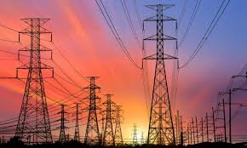
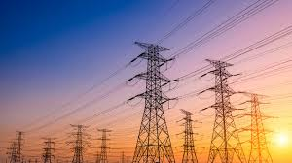
Introduction:-
E-Vidhyut Seva is a comprehensive online platform designed to revolutionize the delivery of electricity services.
Seamlessly integrating HTML, CSS, Bootstrap, and JavaScript, E-Vidhyut Seva aims to enhance accessibility and efficiency in managing electricity-related tasks.
Through intuitive interfaces and advanced functionalities, this project empowers users by providing easy access to billing, service requests, and consumption monitoring, thereby transforming the traditional electricity board experience.

Slide 4

Functionality:-
Home
About Us
E Vidhyut Seva
EODB(Easy Of Doing Business)
Suppliers
Recrutments
Downloads
Privacy Policy
UsefulLinks

Slide 5
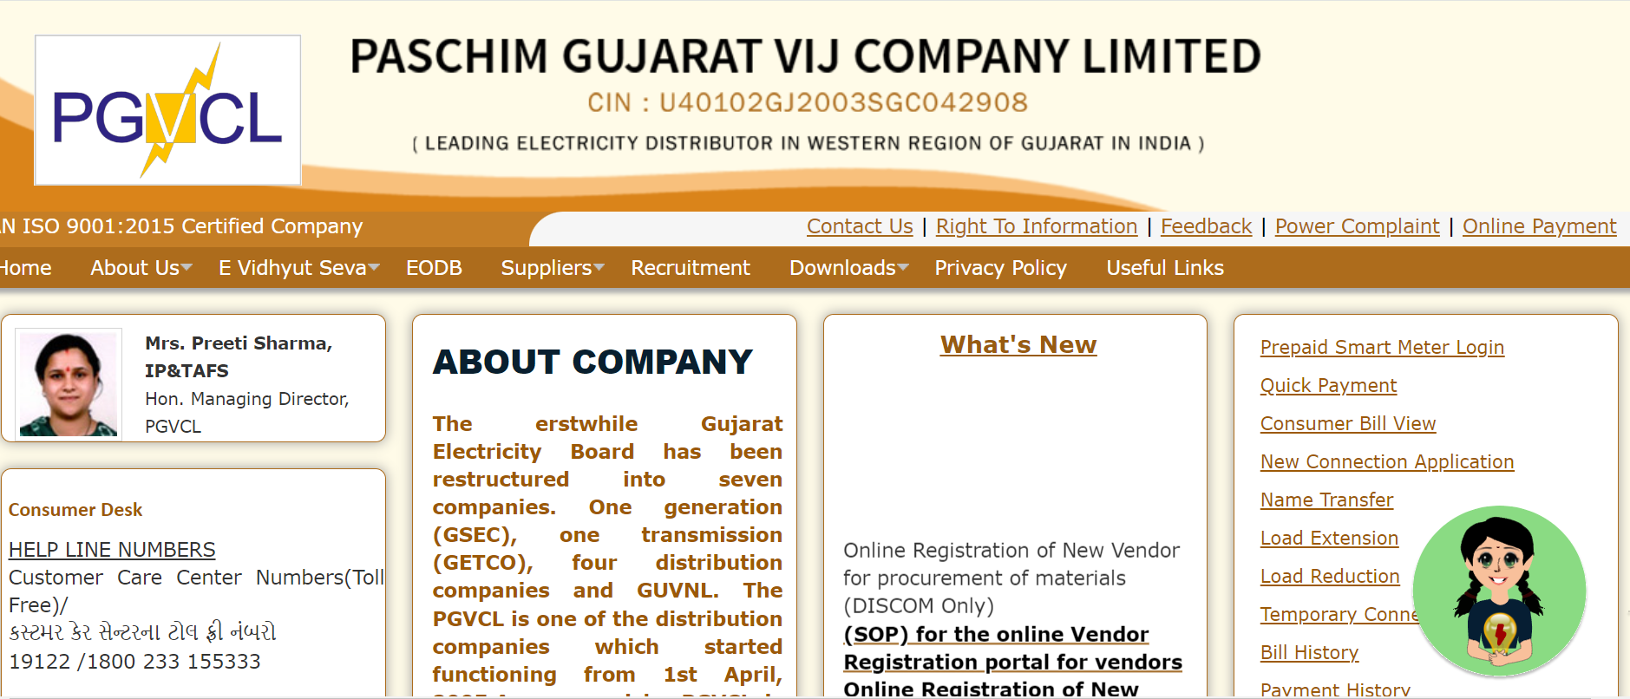
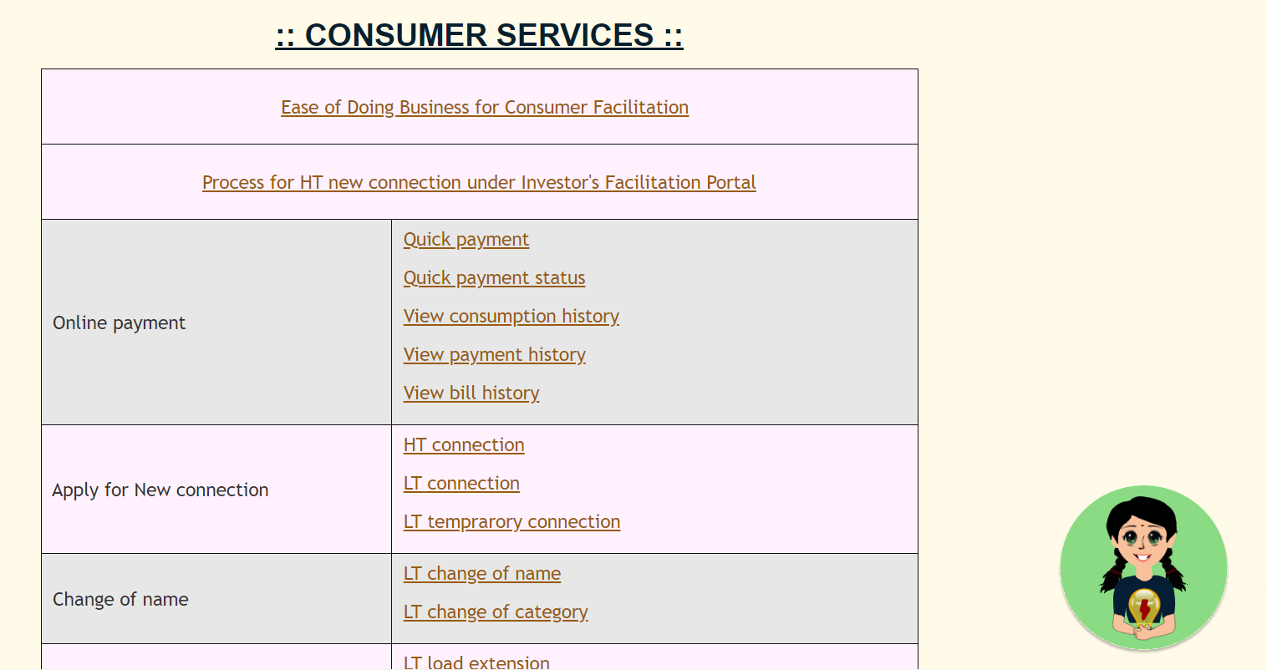
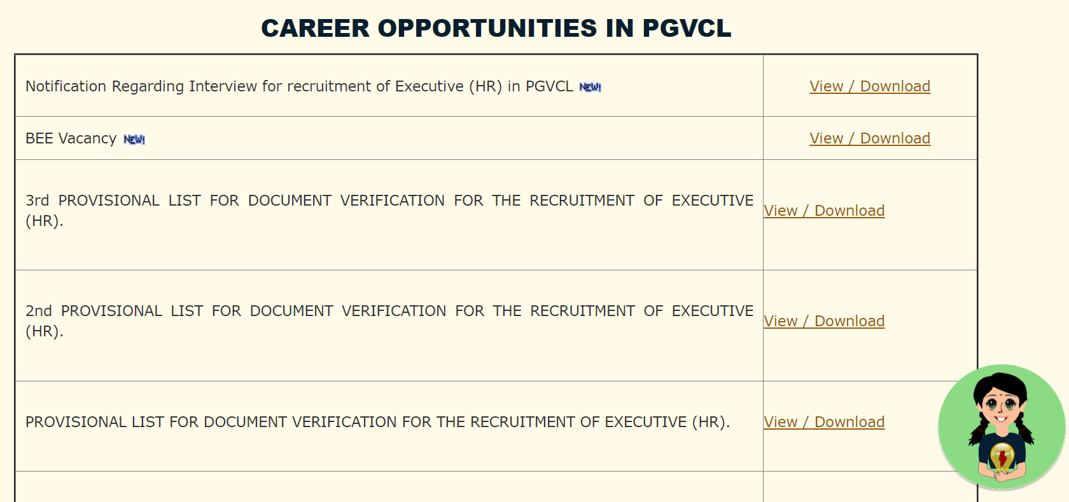
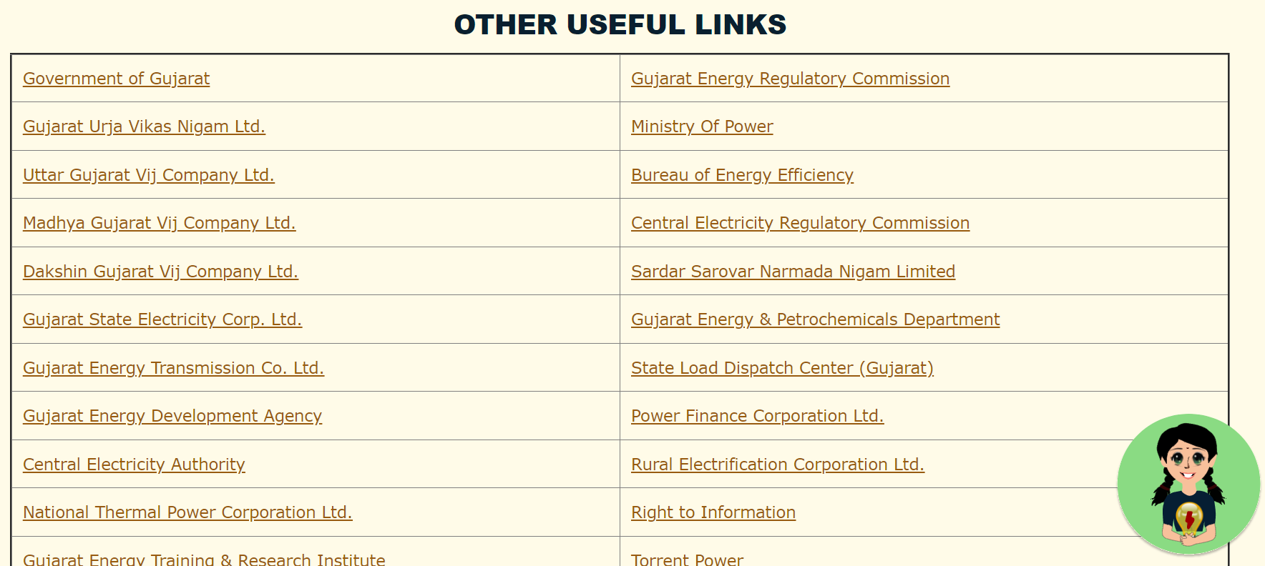
Photo graph of website

Slide 6

Merits & Demerits :-
Merits:-
Enhanced Accessibility
Improved Efficiency
Transparency and Accountability
Customer Empowerment
Environmental Impact
Demerits:-
Digital Divide
Digital Divide
Dependence on Technology
Limited Reach
Resistance to Change
Future scope:-
Integration of Renewable Energy
Smart Grid Integration
Expansion of Services
Enhanced User Experience
Data Analytics and Predictive Maintenance
80
Design Model
Reviews
Sales

Slide 7
Thank you..

